Slide 1


SEG3125: Lab 8
Designing a website of your choice – Part 2
Presented by TA Gurdarshan and TA Anisha
Faculté de génie | Faculty of Engineering
uOttawa.ca

Slide 2
Deadlines
The deadline for lab 8 is March 17th at 11:59PM
This lab is worth 3%

Slide 3
Introduction
‹#›
This lab, you are going to start implementing the website you designed in lab 7
This lab is the part 2 of three labs, in Lab 9 you are going to be completing the website.

Slide 4
Lab 8 Introduction
You have two options:
Web app with React
Mobile app with React Native
You are going to create the website that reflects your lab 7 design

Slide 5
Tutorials
React
Complete React and Redux Introduction
React native
React Native Tutorial

Slide 6
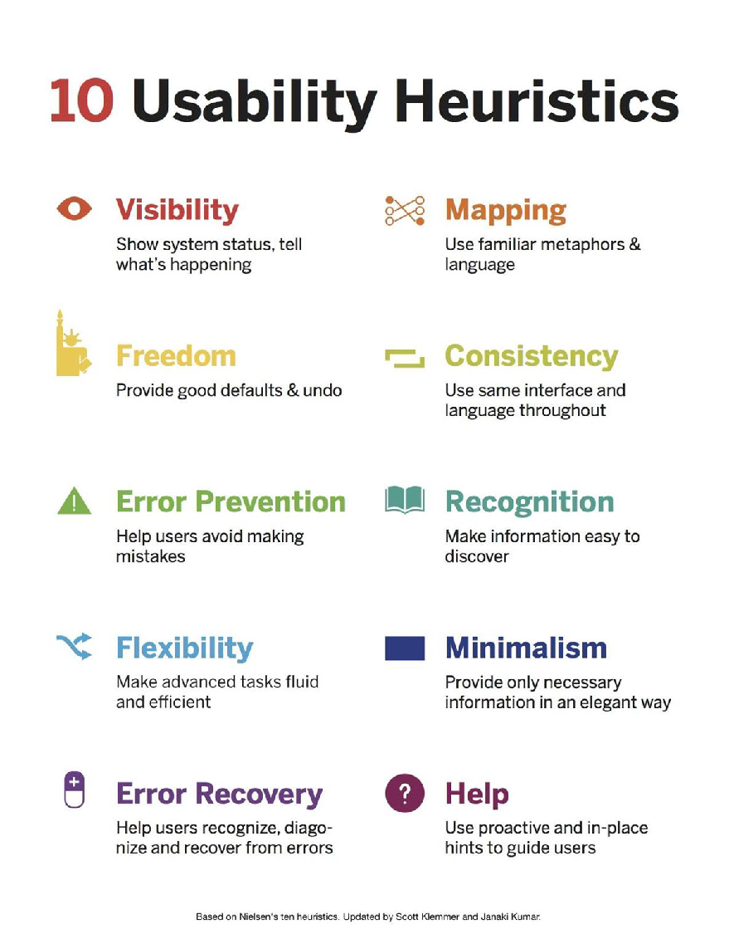
Heuristic Evaluation

Slide 7
Human Interactive Processes
Following instructions
Absorb information
Monitored activity
Exploring
Analyzing results
Production/Design
Communicating
Planning

Slide 8
Requirements
You need to use either React or React Native
You need to reflect your lab 7 design, if you make changes make sure you mention them in the video submission
Focus on the 3 Processes you choose in lab 7
Have a minimally function web app or mobile app

Slide 9
Submission
You will need to submit :
A video showing your progress
No more than 10 minutes
1. Mention why you chose the web app or mobile app.
2. Mention what you are doing to learn React/React Native
3. Mention the changes to your Lab 7 design.
4. Show the connections between your Lab 7 interactive processes and the React/Native components you’ve started.
5. Show how the components you have created so far work.

Slide 10
Starting point
No starting point, follow your lab 7 design

Slide 11
Requirements for lab 9
Complete implementation of your website
Incorporate Bootstrap or other libraries to make your site appealing
Make sure your site is in tune with the usability heuristics
You are going to make your website bilingual (whatever other language you choose)
Add a select a language option
Translate your site to that language (you can use Google Translate)

Slide 12

Questions
18
Any questions???
If you have any question, you can send me an email to TAs

Slide 13
THANK YOU!

